Slide 1
Predicting yardage gained on a play in the NFL with SGD
Michael Harris and Rahul Chamarthi

Slide 2
Abstract:
Goal: Predict the resulting yardage of a play given game context and players-based features.
Application: Aid an offensive coordinator in optimal decision making.
Methodology:
Feature Selection: Focusing on relevant game data and player attributes.
Data Prep: Handling NaNs, infinite values, normalizing data, categorical variables, and creation of derived features.
Model Development: Vanilla GD with LASSO, SGD with LASSO, and PCA Regression.
Evaluation: Comparing the models and assessing the weaknesses of the model and this approach.

Slide 3
Feature Selection

Slide 4
Feature Selection:
The data given to us by the NFL 2023 Big Data Bowl (2022 NFL Season) was exhaustive (near 60 features split across the 3 individual datasets mentioned below). In an effort to reduce the complexity of the dataset we decided to focus on:
Game Data: signedScoreDiff and ballCarrierAge (both needed info from the other datasets as they were derived)
Play Data: quarter, down, yardsToGo, defensiveTeamQt, gameClockinSeconds, preSnapHomeScore, preSnapVisitorScore, playResult(y), absoluteYardlineNumber, passPlay, offenseFormationQt, defendersInTheBox
Player Data: heightInCm, weightInKg, positionQt

Slide 5
Data Prep:
After deciding on the features, we needed to change their value within context of the rest of the data (feature engineering) in order for them to be usable.
This included:
Factorization of our categorical features offensiveFormation, defensiveTeam and position
Conversion of certain features to more standardized units such as; height, weight and gameClock
Creation of derived features from the base features that we were provided in the dataset such as; passPlay, ballCarrierAge, and signedScoreDiff (we’ll go into more detail on these later)
Cleansing of NaN and Inf Values from data that was not correctly filled out or left blank.
Normalization of the Data considering most of the models/algorithms we employed such as; PCA, SGD, and Lasso Regression recommend data that have a standard scale of variance (which required normalization of continuous values like yardsToGo).

Slide 6
Highlighted Examples of Transformed Features
Factorization:
position into positionQt: TE = 1, WR = 2, RB = 3, QB = 4, FB = 5
Conversion:
gameClock into gameClockInSeconds: 7:52 (min:seconds) = 472 seconds
Derived Features:
ballCarrierAge: gameDate (from Game Data) - birthDate (from Players Data), and player identified (from Plays Data)
Cleansing:
Elimination:
defendersInTheBox only 5/12487 rows contained nulls so we dropped those rows
Mean:
ballCarrierAge resulted in 3017/12487 rows containing nulls; considering our already small dataset we decided to fill the nulls with the mean of the feature

Slide 7
Final Working Dataset
12482 rows
16 features: quarter, down, yardsToGo, defensiveTeamQt, gameClockinSeconds, preSnapHomeScore, preSnapVisitorScore, absoluteYardlineNumber, passPlay, offenseFormationQt, defendersInTheBox, signedScoreDiff, ballCarrierAge, heightInCm, weightInKg, and positionQt
1 y label: playResult (in yards)

Slide 8
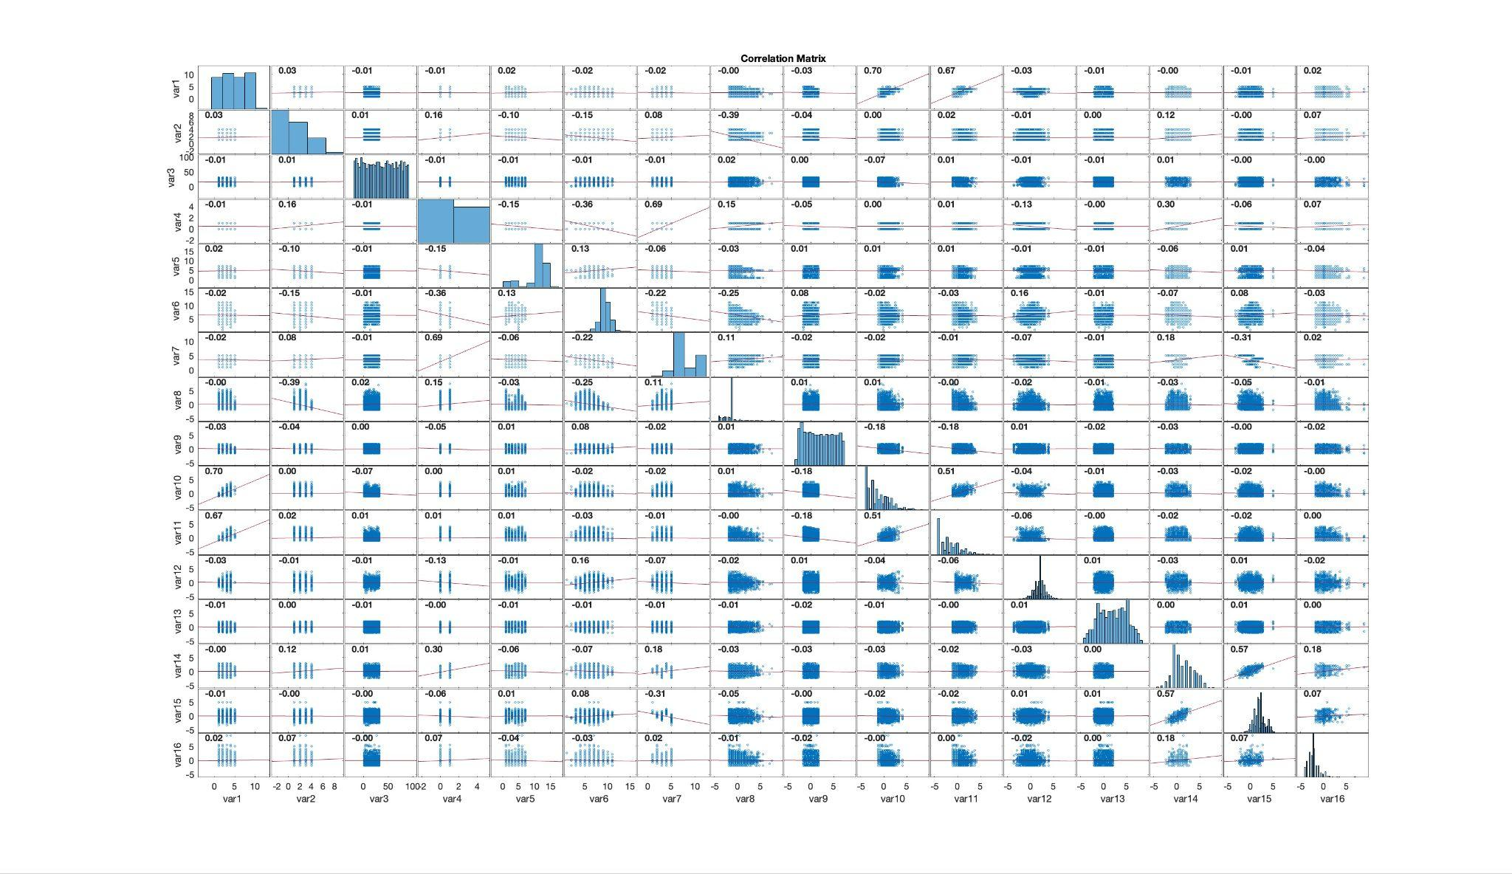
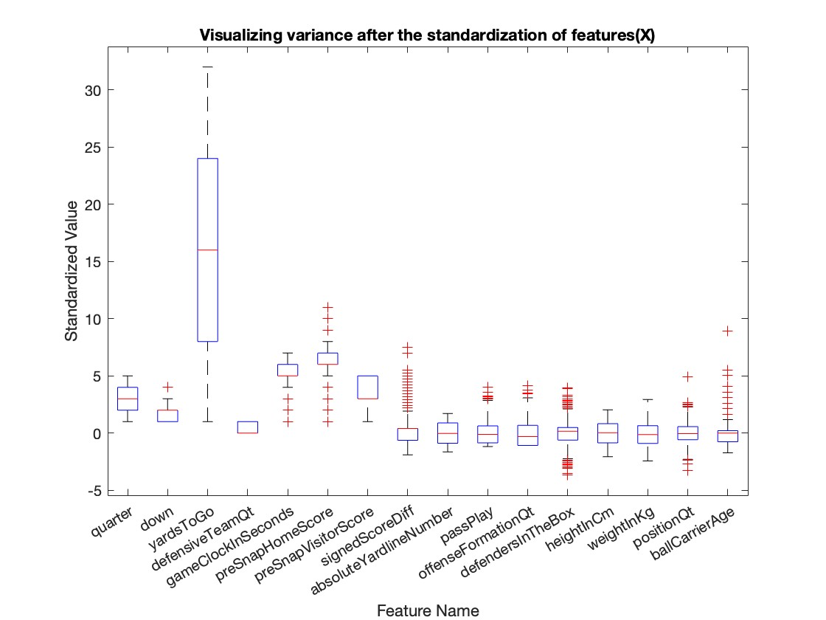
Preliminary Dataset Analysis
plotting distribution of our input features
visualizing the binary correlations between input features
Notes:
Heatmap Correlations:
quarter and passPlay
quarter and offensiveFormationQt
passPlay and offensiveFormationQt
Correlations we might have expected to see but did not observe:
offensiveFormationQt and defendersInTheBox

Slide 9
Model Development

Slide 10
Model Development
3 Approaches:
Vanilla GD with LASSO
SGD with LASSO
PCA Regression

Slide 11
Implementation of Lasso with Vanilla GD and SGD
What is SGD and how is it different from Gradient Descent?
Model Updates: SGD updates globally after one data point (or a mini batch)
Faster Iterations: More random and frequent updates.
Erratic convergence: Faster but oscillates around the minimum unlike GD which smoothly converges to a minimum.
What were some of the challenges we faced in implementation?

Slide 12
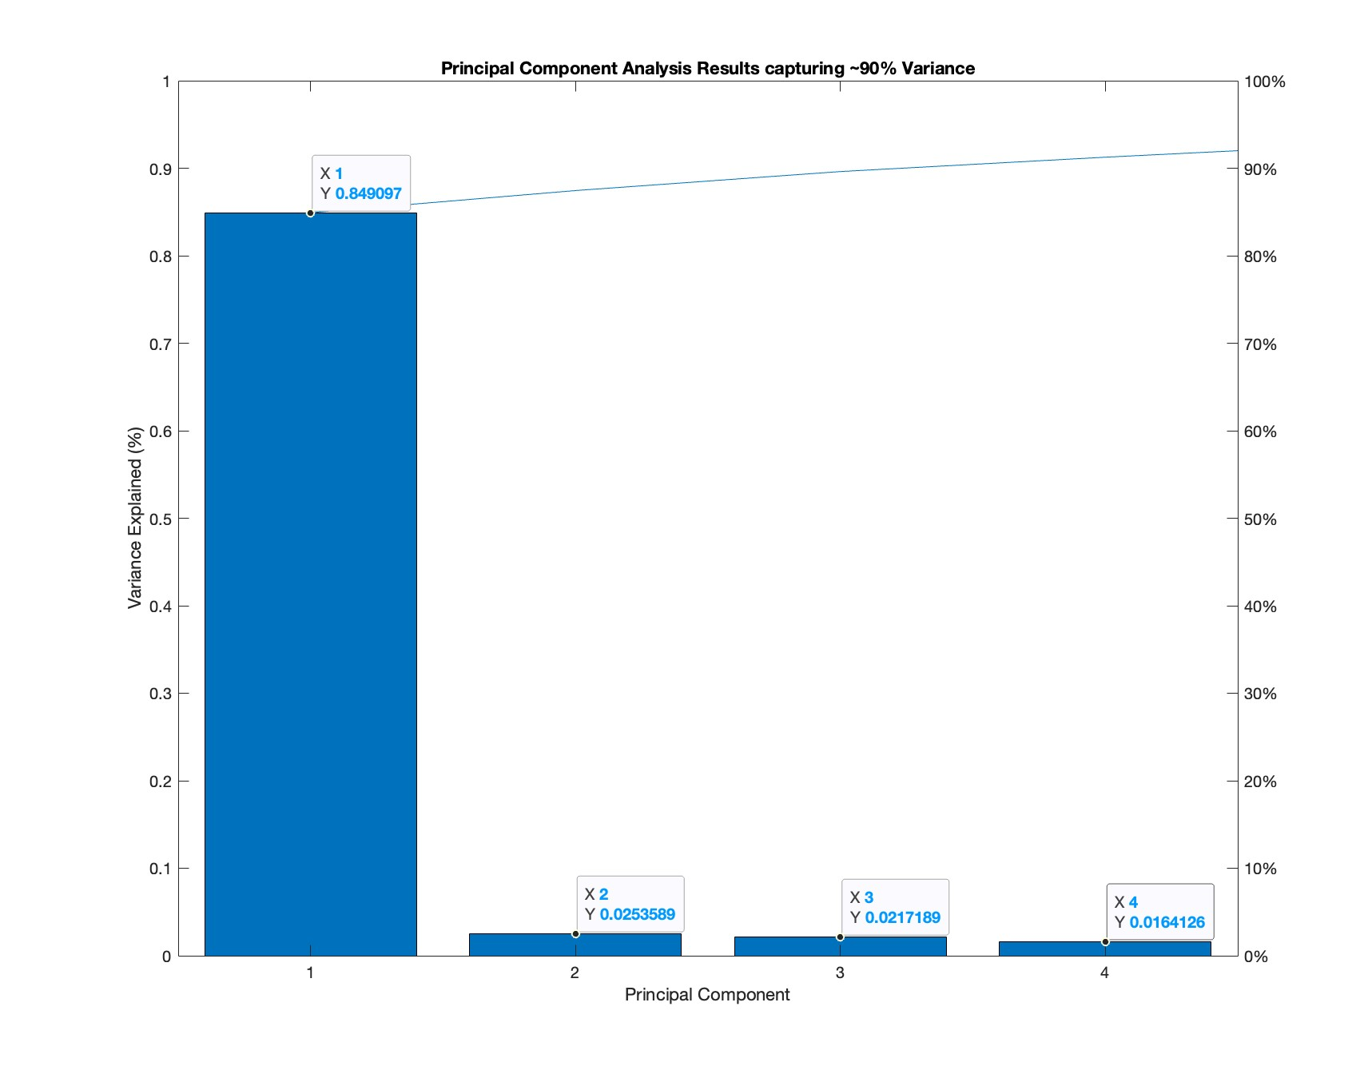
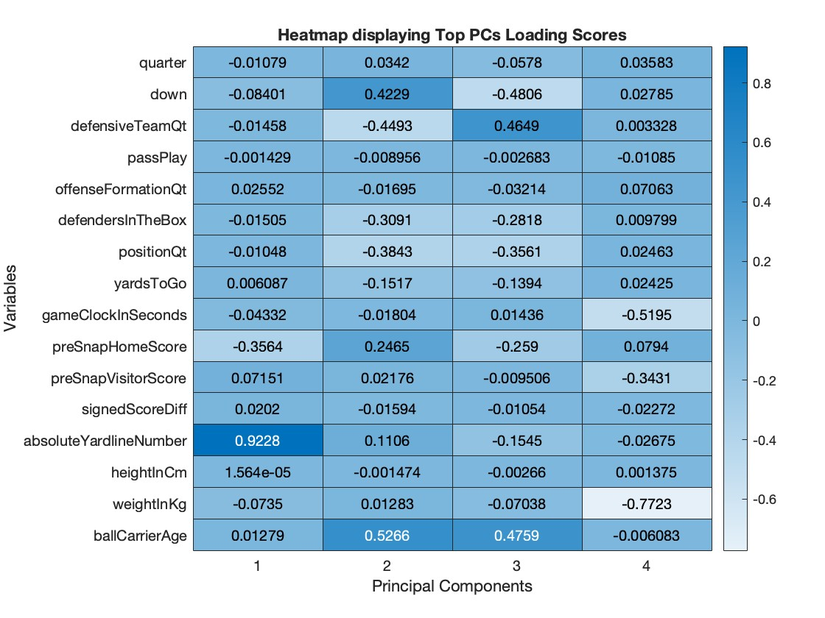
PCA Discussion
We implemented PCA analysis to attempt to observe correlation between our features and to see if there was merit in dimensionality reduction (we’ll discuss this later)
An idea supported in the Scree Plot and Heatmap below; showing support for some underlying correlation in our input features
Notes:
PC1 showing so much of our variance clearly indicates some underlying correlations and potential for reduction
While summarizing a singular emphasized underlying factor beneath each of these PC’s may require domain knowledge, we think as sport’s fan’s we can make some assumptions haha
PC1: strong positive links to position on the the field(absoluteYardlineNumber), and negative associations with the preSnapHomeScore gives some feel that this PC heavily weighs context of the play (position on the field)
PC2: positively linking ballCarrierAge, absoluteYardLineNumber, preSnapHomeScore, and the down while negatively associating with the defensiveTeamQt, positionQt and defendersInTheBox (hard to exactly interpret as this PC tends to span several topical areas)
PC3:

Slide 13
Evaluation

Slide 14
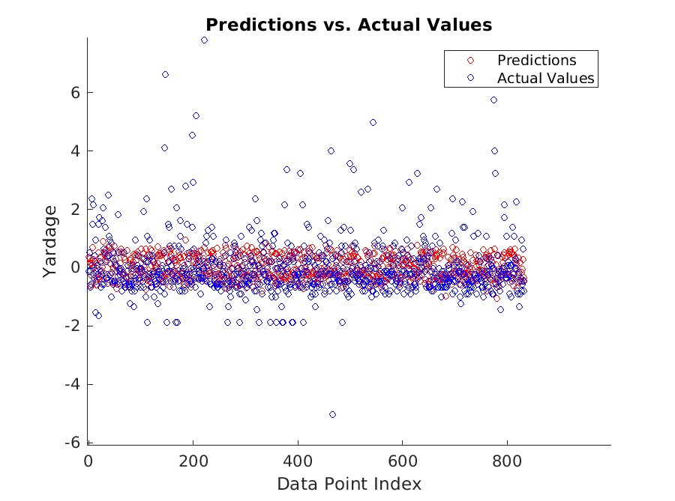
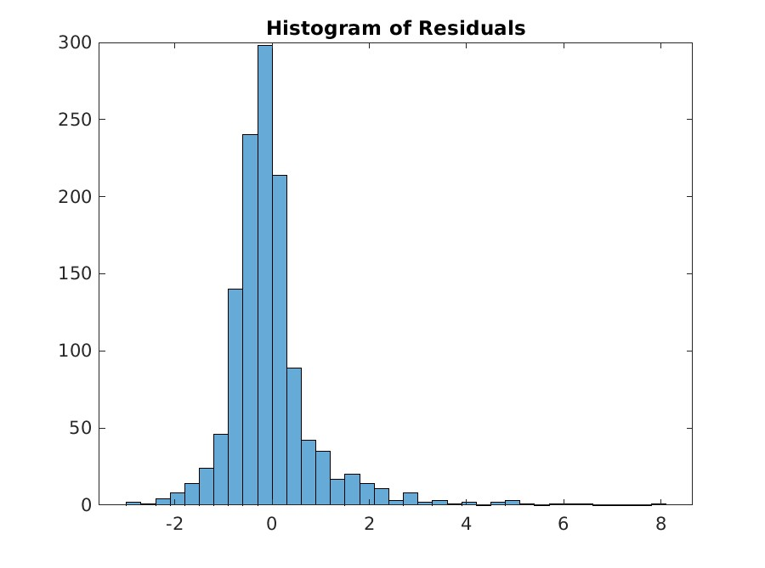
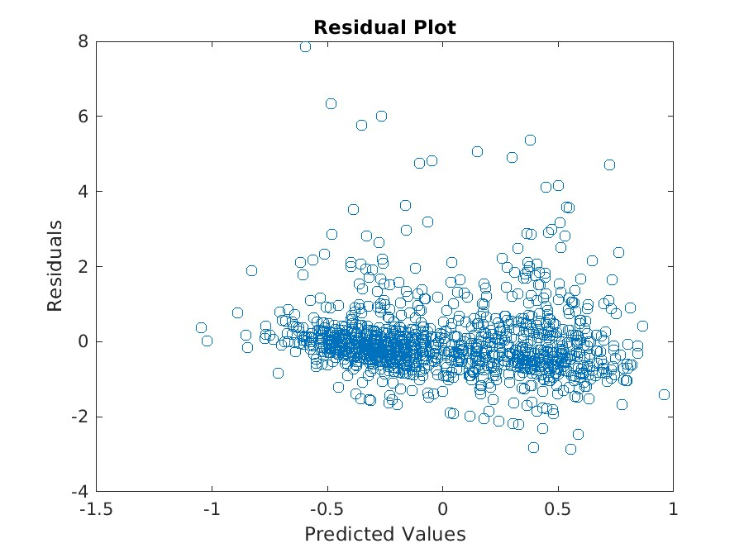
Evaluation Vanilla GD:
 | Vanilla GD: | SGD:
MSE: | 0.8849 | 1.0976
Y_STD: | 9.1851 | 9.1851
RSE: | 8.6972 | 9.6487
TIME: | 3.8191(s) | 0.1024(s)
NOTE: All of these graph are standardized (mean is zero and standard deviation is one)

Slide 15
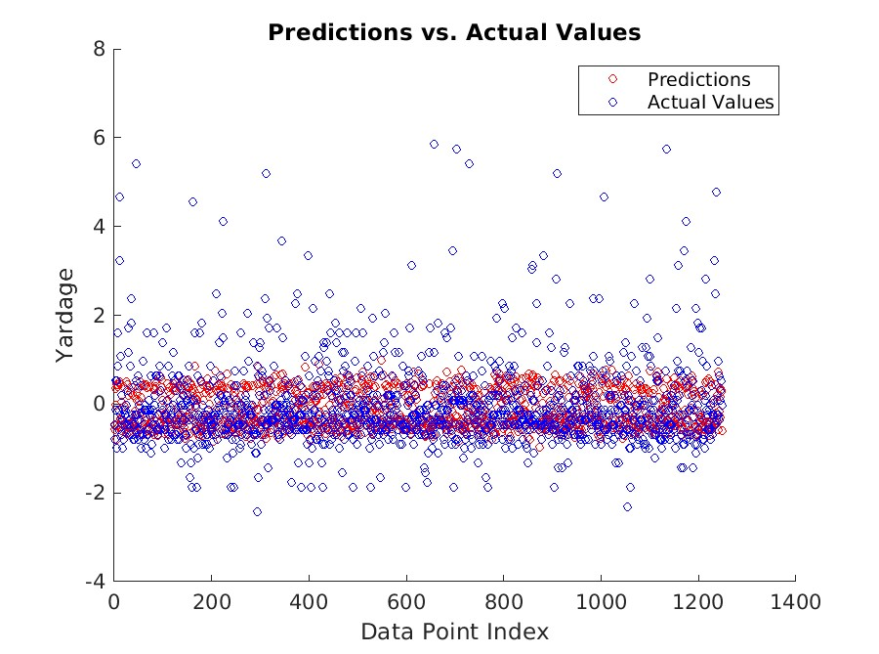
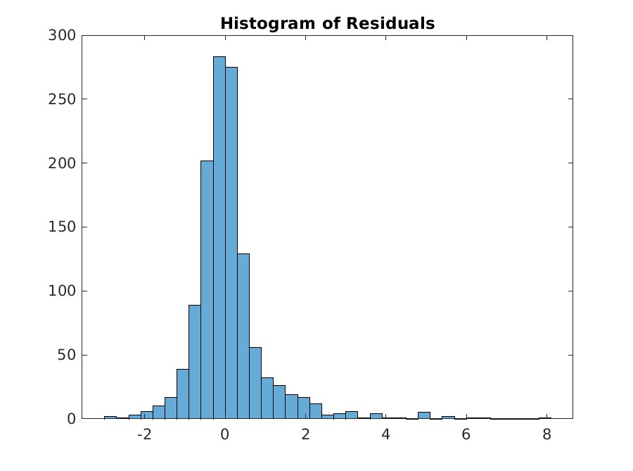
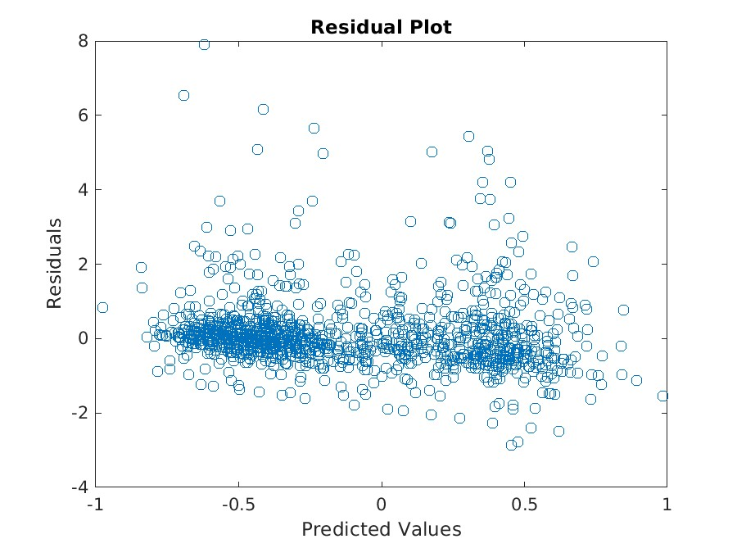
Evaluation SGD:
 | Vanilla GD: | SGD:
MSE: | 0.8849 | 1.0976
Y_STD: | 9.1851 | 9.1851
RSE: | 8.6972 | 9.6487
TIME: | 3.8191(s) | 0.1024(s)
NOTE: All of these graph are standardized (mean is zero and standard deviation is one)

Slide 16
PCA Regression Results
Following the dual implementation of our Lasso Algorithm we wanted to test the merit of dimensionality reduction we mentioned earlier; fitting a linear regression model using the PC’s to define input.
The top 4 PCs that explained ~90% of variance were used as the input features
Multiplying the PCs by the training data to map the data to a lower dimension, and then using the closed form solution for Linear Regression to obtain predicted y_values
The below table contains our initial results (pre - K Cross Validation) :
 | PCA Regression
MSE | 0.9141
Y_STD | 9.1851
RSE | 8.8039
Notes:
A we can see the results are very much in line with our expectations

Slide 17
Ablation Analysis Discussion:
What were some issues with our approach?
What were the inherent issues with predicting non-stationary events?
What could have performed better?
How might we go about improving performance?

Slide 18
Q & A

